Slide 1
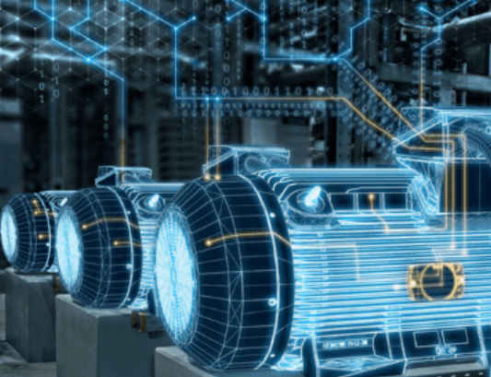
Induction Motor - Test Time Minimization using Data Analysis and Predictive Modelling
Mentor : Prof. Sumanta Basu
Name | Registration No. | Email ID
Nildeep Mukherjee | IIMCAPDS5/VCNOW/000129 | nildeep@gmail.com
Aman Verma | IIMCAPDS5/VCNOW/000263 | amannov1992@gmail.com
Savio Rego | IIMCAPDS5/VCNOW/000127 | saviodorego@gmail.com
Nilanjana Kalita | IIMCAPDS5/VCNOW/000063 | kalitanilanjana@gmail.com
Ashwini Agarwal | IIMCAPDS5/VCNOW/00315 | ashwini.royal@gmail.com
Chandramouli Chakraborty | IIMCAPDS5/VCNOW/00023 | chandramouli.209@gmail.com
Poorbi Agarwal | IIMCAPDS5/VCNOW/000163 | poorvi.agarwal1805@gmail.com
Suneel Beluraiah | IIMCAPDS5/VCNOW/000232 | sbeluraiah@gmail.com
Nishant Kumar | IIMCAPDS5/VCNOW/000164 | nishant.5.kumar@gmail.com
APDS05 – Group No 1

Slide 2
Project Synopsis
Section 1
Analysis of Business Case with respect to investment and time
Section 2
Principal time component analysis using testing time pareto
Section 3
Examining and understanding existing system of data capturing in Industry 4.0 environment for ensuring data quality
Section 4
Visualisation of Objective for effective solution formulation and interpreting data frame
Section 5
Descriptive statistics on dataset for establishing co-relation and verifying causation with help of Subject matter expert
Section 6
Formulating the solution framework and finalisation of models for prediction
Section 7
ML Model stepwise analysis with jupyter notebook and codes, with mapping of AI accuracy and recall to support business case
Section 8
Hypothesis testing across product category for ensuring solution effectivity with respect to business objective
AD hoc insight from existing case study

Slide 3
Business Case – Make in India
The CEO of a global electric motor manufacturing company was planning to increase production volume of MV Induction motor at their India facility .Since the demand for this product line has suddenly increased post the heavy duties levied by the Govt of India on imported motors and also after the announcement that Govt projects shall buy only from those who manufacture in India . Global leadership wanted to use this headwind for increasing company's revenue.
The Business Leader for the MV motor manufacturing unit was under lot of pressure , ongoing war between Ukraine and Russia indicated towards a global economic slump and at this juncture he was not much willing to risk a lot of capital investment to alleviate the main bottleneck which is testing infrastructure and come up with a new test plant to increase production.
He was apprehending an economic slowdown across India ,which means the order inflow can dry up at point of time. This would mean to payback the amortisation cost in the next quarter by keeping the profit intact the company will have to walk the path of fixed cost reduction.
From the Organization brand and reliability point of view ensuring the right product quality at the first time was most important.
Afterall in a niche market customer satisfaction ensures repeat customer and continuous business , he decides to approach the experts at IIM Calcutta for an amicable solution that would address the critical business need.

Slide 4
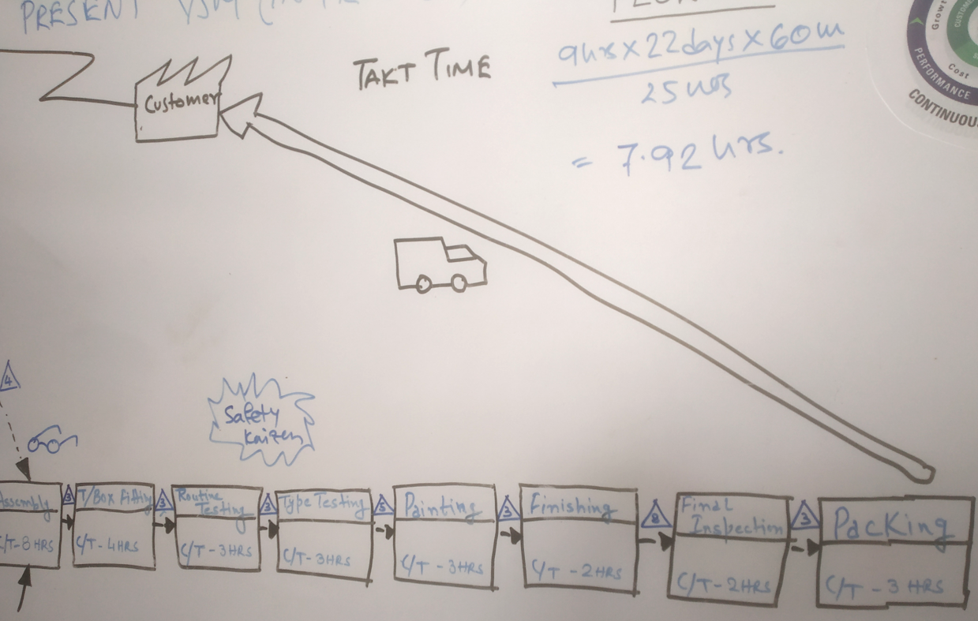
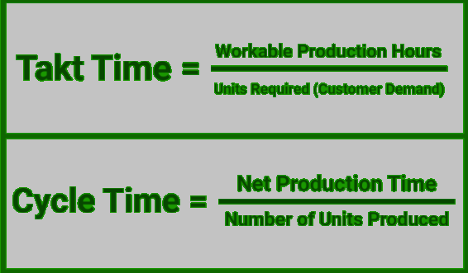
Understanding the problem in depth and analyzing constraints.
Bottleneck Analysis done using Lean Six Sigma tool Value Stream Mapping ,
Pareto analysis shows the significant contributors which contributed to almost 95% of the bottleneck that requires time and investment.
The company operates in a Design , Assembly , Test ,Finish mode and apart for some special processing that are done inhouse. All machined components are outsourced from different approved sub vendor using Product Part Approval Process.
Sl no | Process Name | Constraint | Mitigation Plan | Capital Cost (Inr) | Fixed running cost/year (Inr) | Time (WEEK)
1 | Routine Testing | Testing Time | New Test Plant required to accocmodate motors | 18000000 | 472000 | 32
 |  |  | Find alternate method for minimizing testing time of each motor using predictive data modelling |  | 12000 | 5
2 | VPI (Inhouse special process) | VPI chamber | Put new VPI chamber and automatic valve for vacum and pressure pumps | 570000 | 110000 | 8
3 | Assembly | New Bay | Flooring , Overhead Crane, Tools, Re augmented labor | 3200000 | 170000 | 6
4 | Finishing | Paint Chamber | Add new drying chamber to effectively utilize Paint booth | 500000 | 60000 | 6
Sample VSM

Slide 5
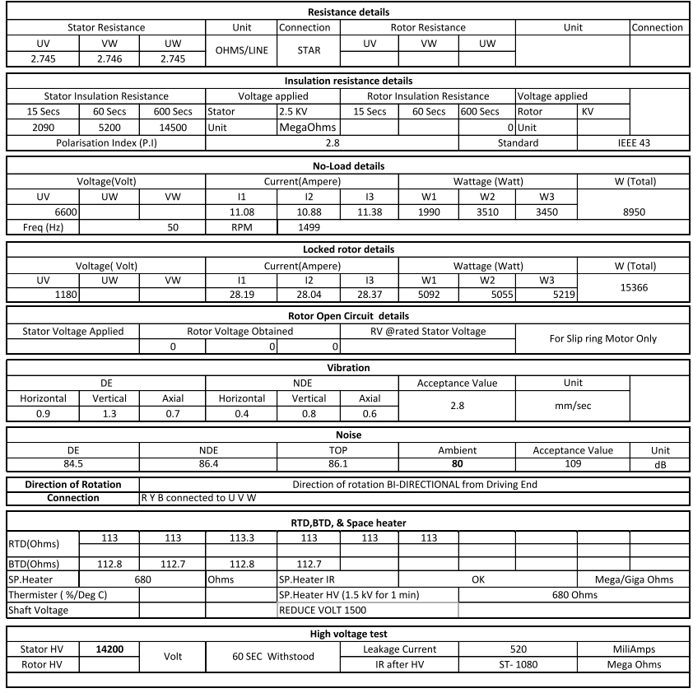
Test report pareto analysis
SAMPLE TEST REPORT
Inference : Minimising the Bearing Temperature and Vibration Stabilisation time will effectively contribute to lesser testing time with reduced power consumption and create room for testing more motors

Slide 6
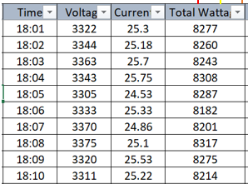
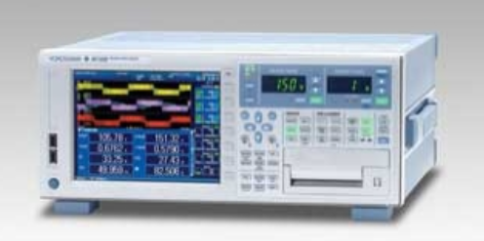
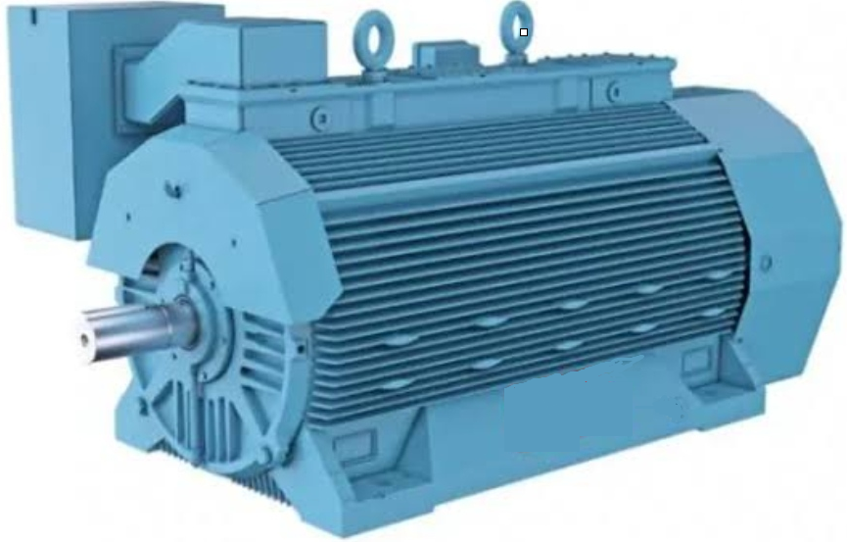
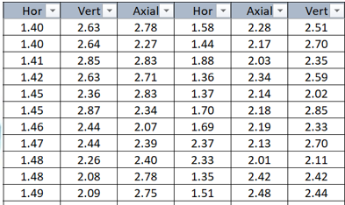
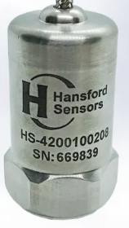
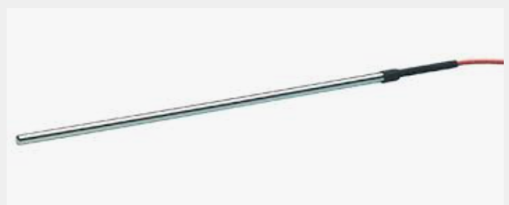
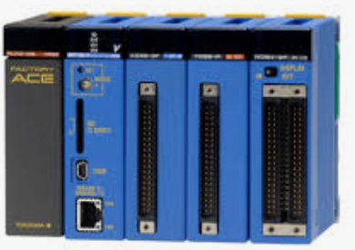
Interpreting the data framework and ensuring data quality
Each motor will have 80- 120 data sets approx..
Data Type – Continuous ,Time series
Electrical Data
Power Analyzer
Yokogawa –WT1803 E Power analyser (0.05% of reading plus 0.05% of range)
Communication protocol :Ethernet (TCP/IP)
Mechanical Data
Vibration Sensor
Monitran Vibration sensor MTN/1186C series (Transverse sensitivity +/- 0.05 and temperature sensitivity 0.08%/Deg C)
Temperature Sensor
Thermal Data
PT-100 Temp sensor radix make (±0.05°C from -80°C to 200°C or 0.1°C at other temperature ranges)
Product Sl no : RXTEFC1
PLC
PLC -- Allen Bradley
Micrologix 1100 RX Logix 500
(Overall accuracy -20…65 °C (-4…149 °F) ±1.0% of full scale)
Communication protocol :Ethernet (TCP/IP)

Slide 7

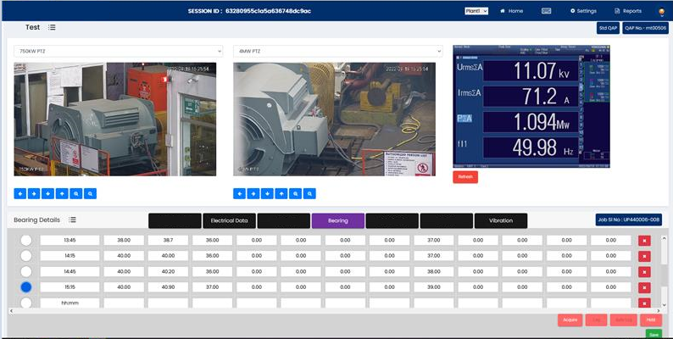







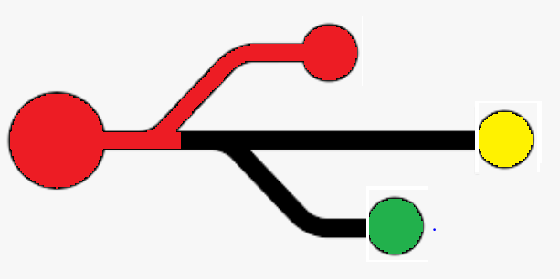

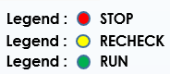
Decoding the application architecture : Extracting data for on line processing
Application Interface
Frontend /UI
Backend
Database
Programming Language
Web server
Vibration Table
Bearing Temperature table
Output
data table synced over real time
AI/ML Model
ETL

Slide 8



















Technical Architecture
Machine Learning Framework
Connector Framework
ETL/Data Curation Framework
Train
Test
Predict
Timeseries
OPC UA/DA
Current, Temp,
Vibration
Archival Zone
Motor
Timeseries
Python
OSI PI
Azure Data Factory
Current, Temp,
Vibration
Motor
Landing Zone
Timeseries DB
Relational DB
Object DB
Curated Zone
Timeseries DB
Relational DB
Object DB
Application Layer
Lambda
AWS Kinesis
Batch Data
Custom
Current, Temp,
Vibration
API
AWS Glue
Historians/DBs
AWS DMS

Slide 9
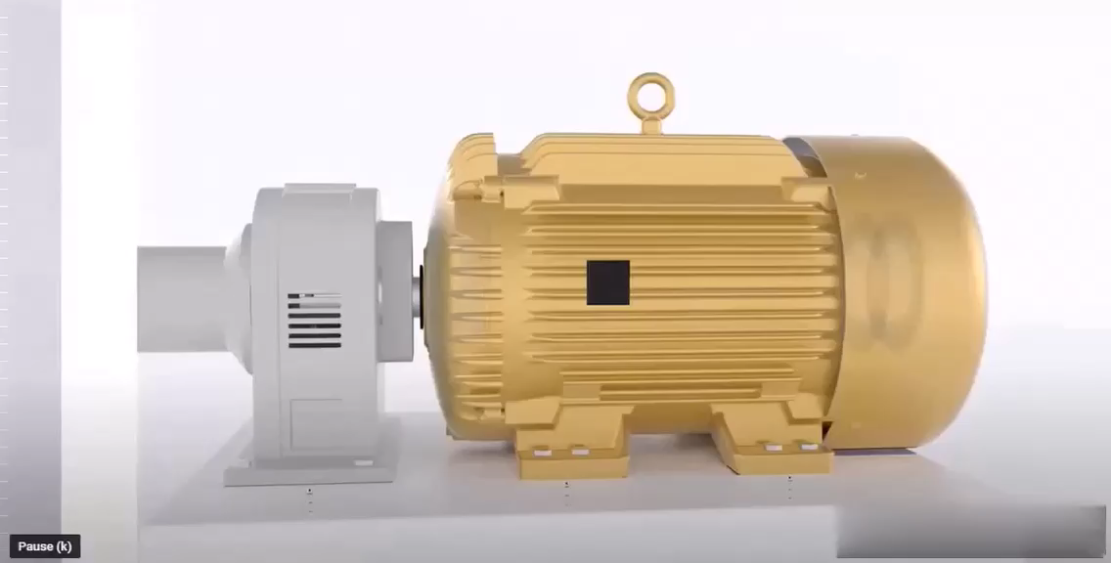
Decoding the master plan
: Achieve prediction of bearing temperature and vibration stability after 1 hour of running and stop motor if prediction satisfies the pre-set limit
Target
Objective : If both prediction indicates stability below the pre-set cut off points as per standard generate output accordingly.

Slide 10
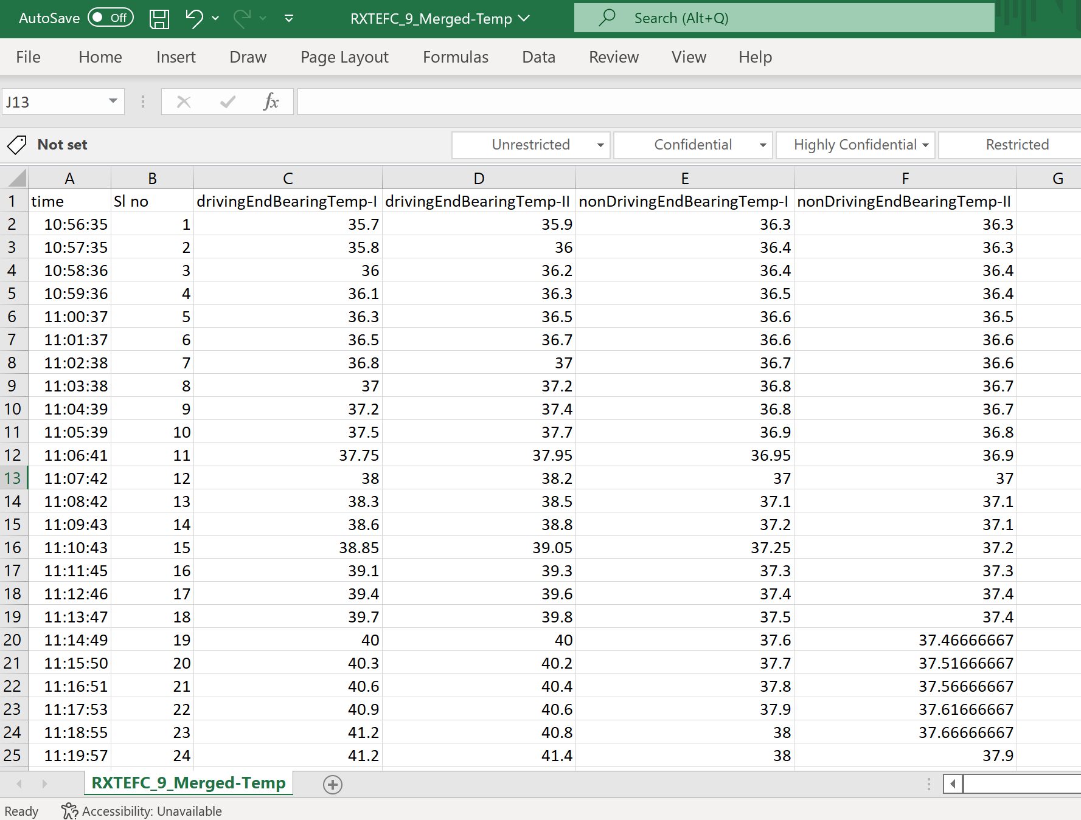
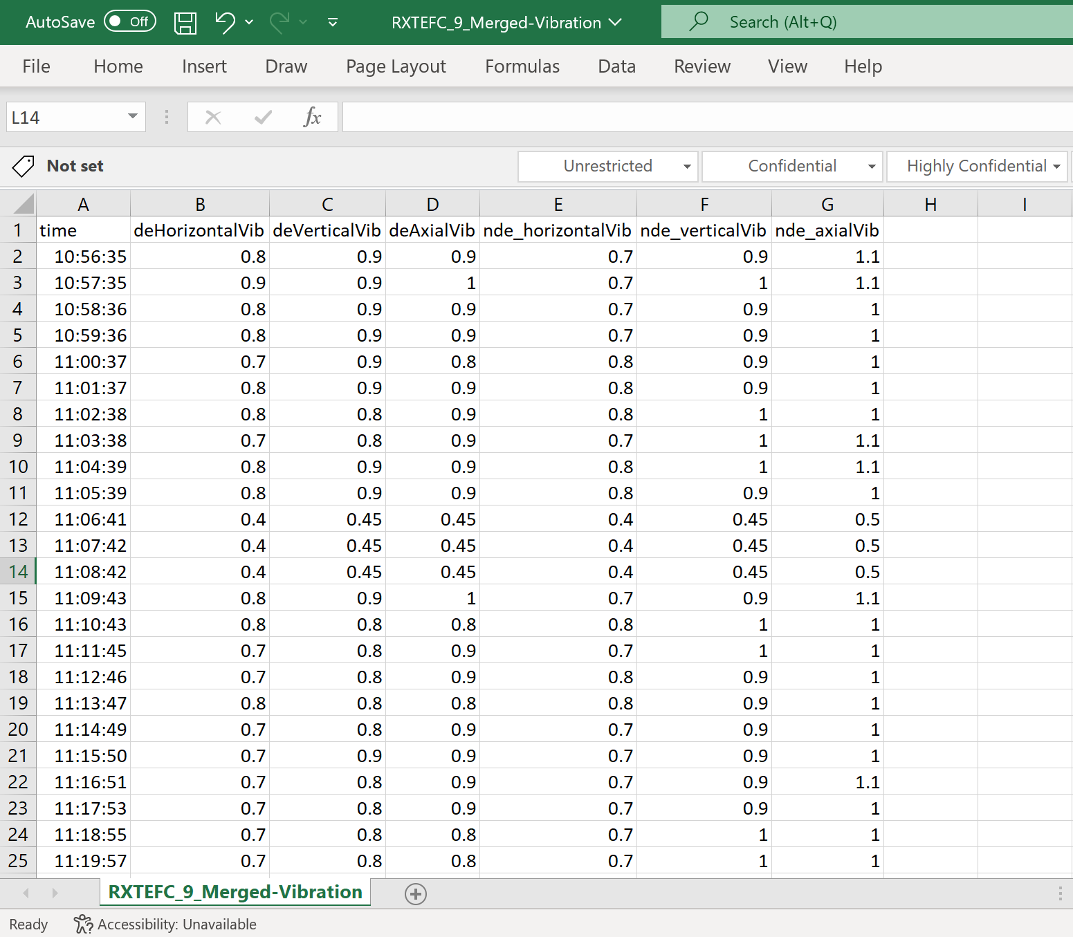
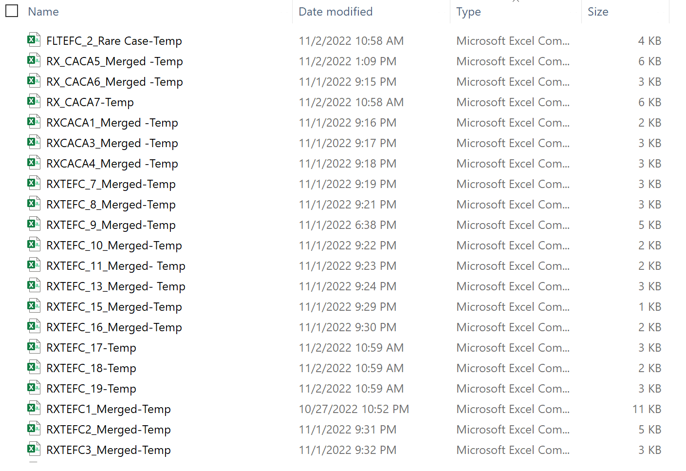
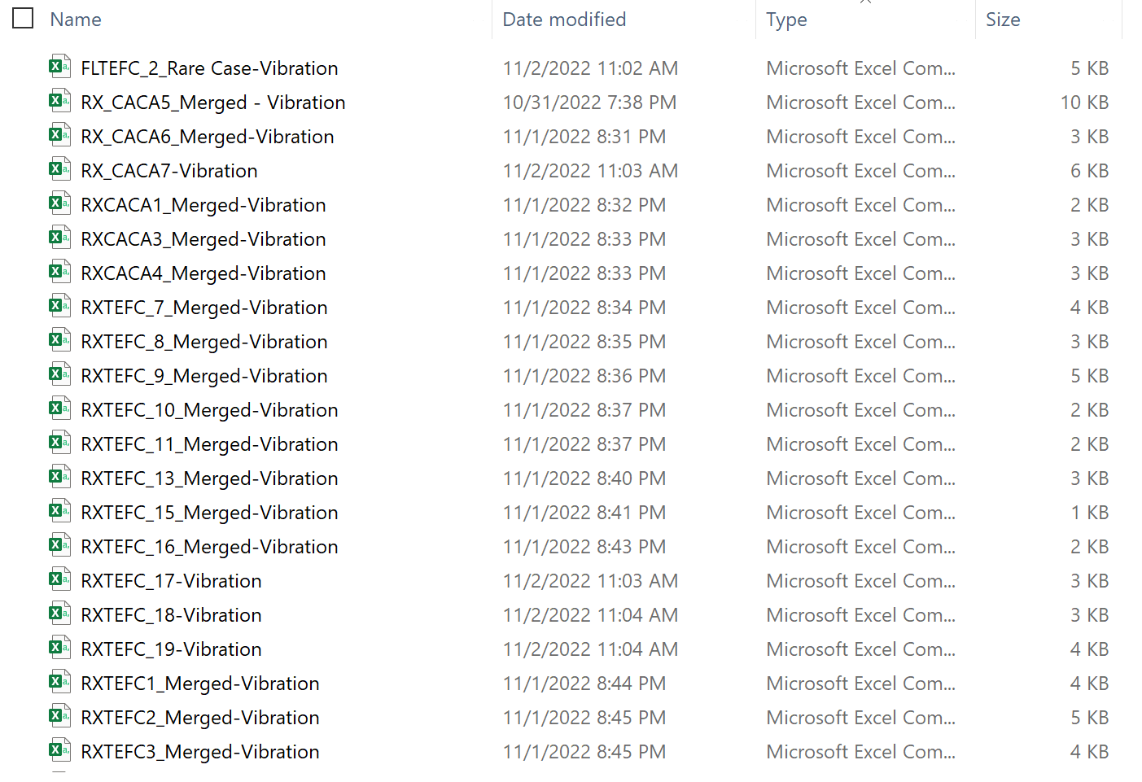
Data Snapshot
Temperature
Vibration

Slide 11
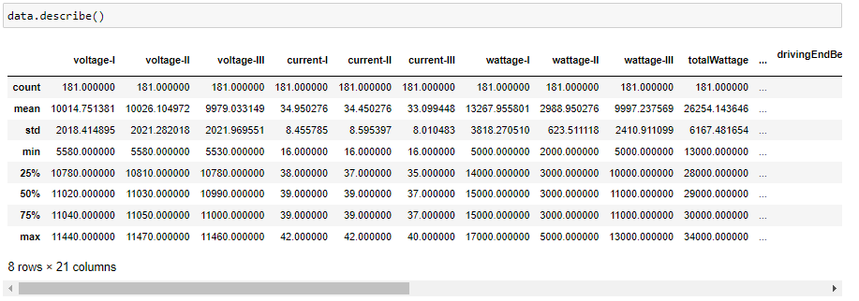
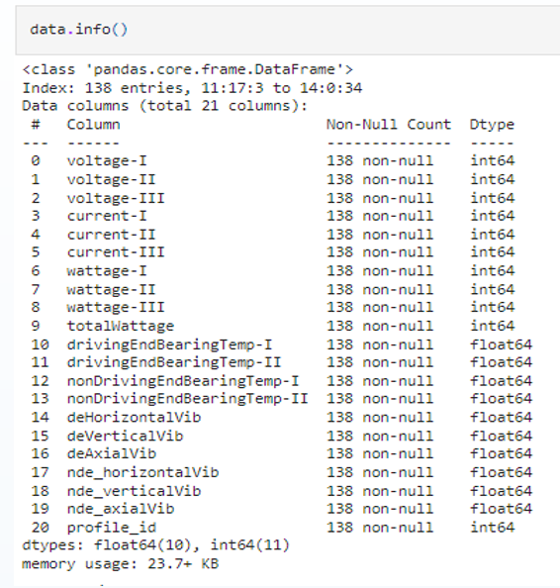
Descriptive Statistics
Pandas DataFrame.describe() is used to generate descriptive statistics. Descriptive statistics include those that summarize the central tendency, dispersion and shape of a dataset’s distribution, excluding NaN values.
Pandas DataFrame.info() is used print concise summary of a dataframe. This method prints information about a DataFrame including the index dtype and columns, non-null values and memory usage.

Slide 12
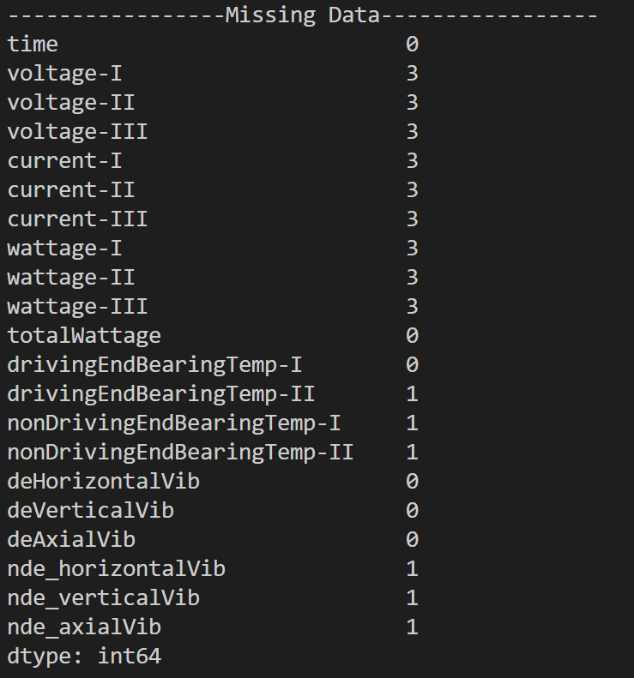
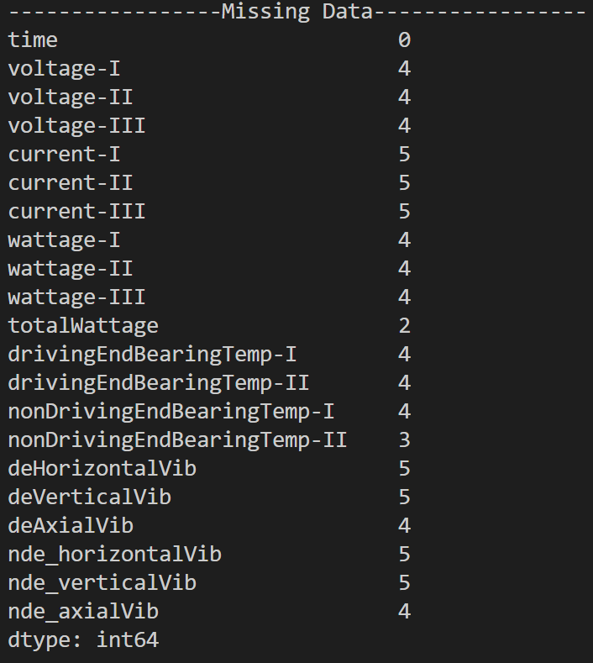
Missing Data
Pandas python library “isnull()” API helps to detect missing values. This returns Boolean output which we are summing it up to count missing values over entire data frame.
df.isnull().sum()
Below is the snapshot from 2 sample dataset-

Slide 13
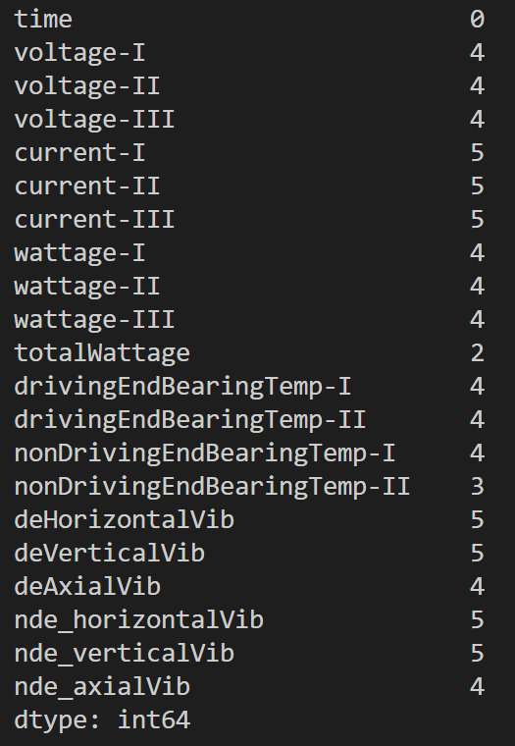
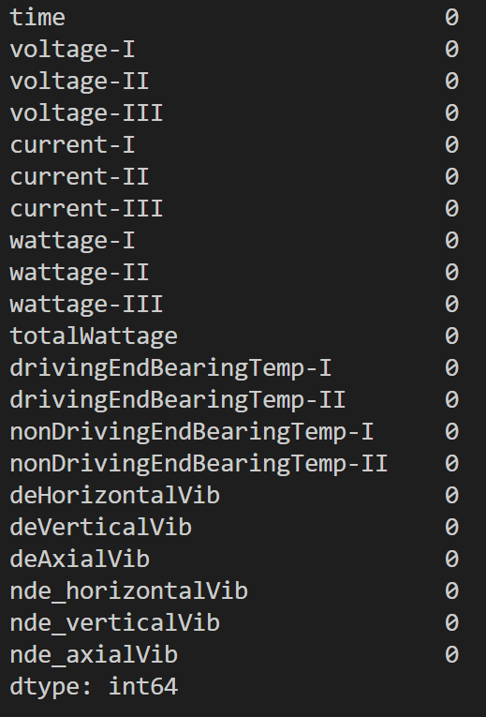
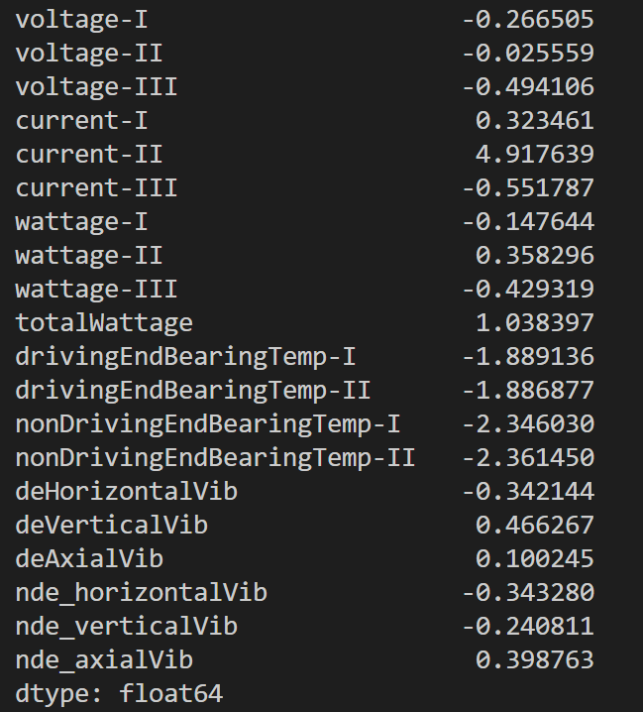
Data Imputation Technique
We have used “mean imputation” wherever data is not skewed and “median imputation” wherever data is highly skewed.
df.fillna(df.mean())
df.fillna(df.median())
Missing Data on Initial Dataframe
Missing Data post data imputation
Skewness for 1 sample dataset

Slide 14
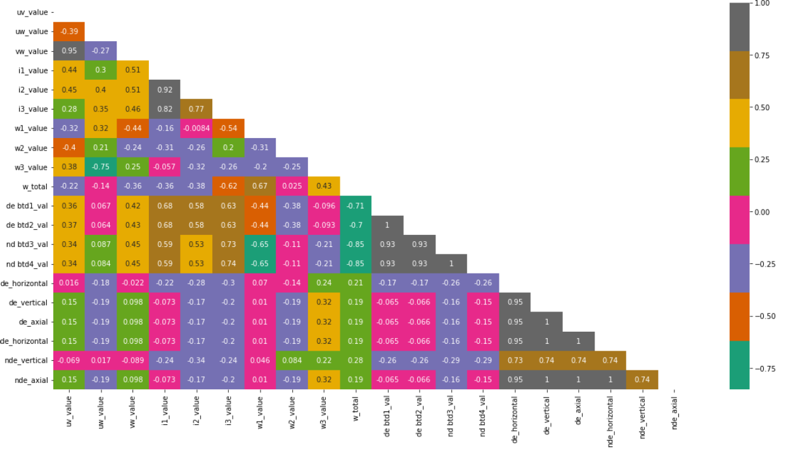
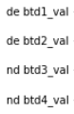
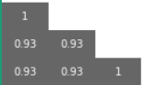
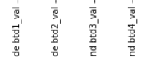
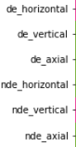
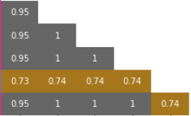
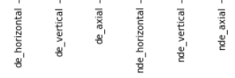
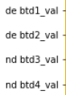
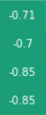
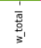
Data Co-relation matrix
Used for problem solving using machine learning
Valuable ad-hoc insight as outcome of entire study

Slide 15



Solution Block Diagram
Bearing Temperature prediction
Vibration future value prediction
Bearing Temp data
Vibration Data
ETL
ETL
Recurrent Neural Network
Linear Regression
Accuracy threshold
Limiting temperature
RMSE
Limiting value
If all the accuracy scores are high generate signal STOP , if anomaly observed in any step generate signal RUN. If any value observed beyond specified limit generate signal CHECK.

Slide 16
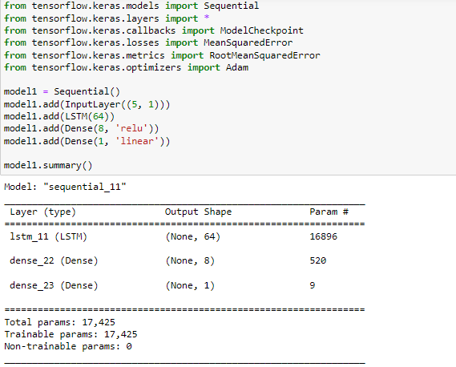
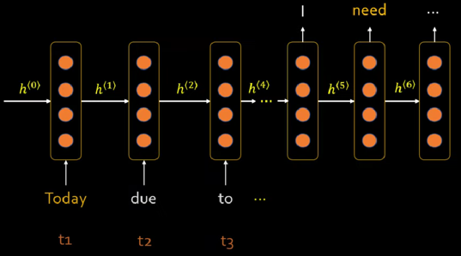
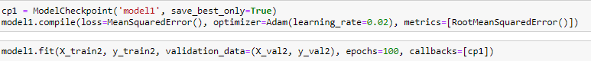
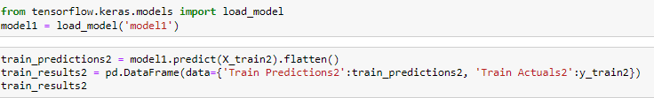
RNN - LSTM
A recurrent neural network (RNN) remembers past inputs due to an internal memory which is useful for predicting the next value.
In the traditional neural network, the inputs and the outputs are independent of each other, whereas the output in RNN is dependent on prior elementals within the sequence.
The Long Short Term Memory (LSTM) designed to prevent both decaying and exploding gradient problems. Just like RNN, LSTM has repeating modules, but the structure is different. Instead of having a single layer of tanh, LSTM has four interacting layers that communicate with each other. This four-layered structure helps LSTM retain long-term memory.

Slide 17
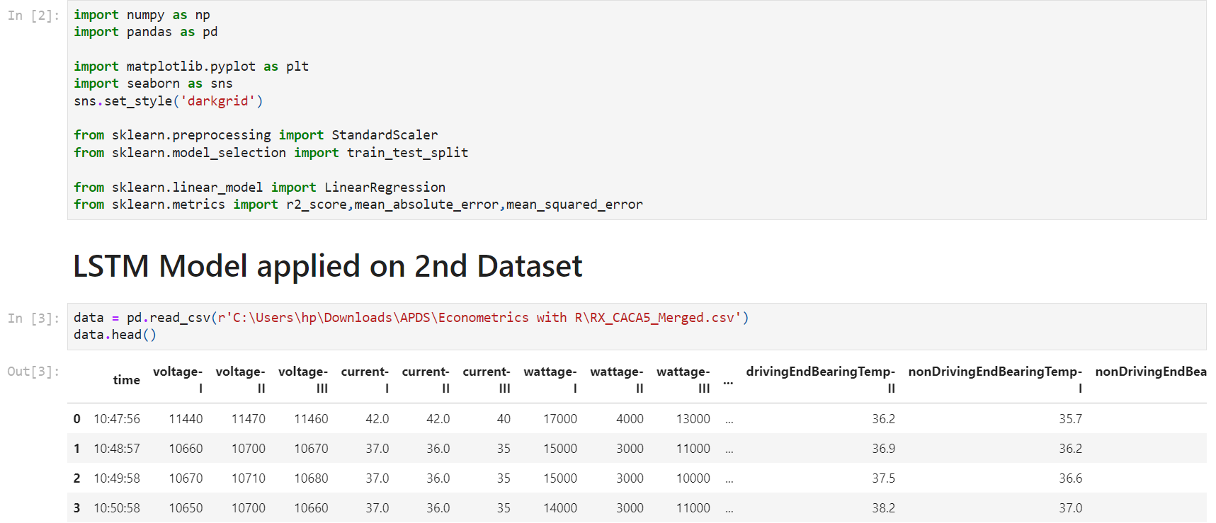
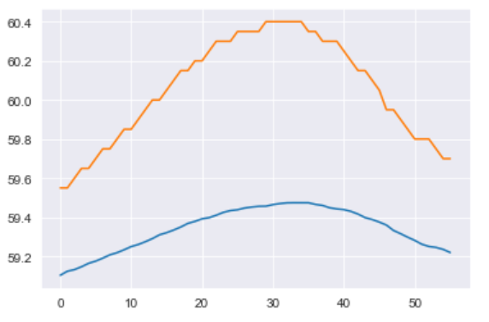
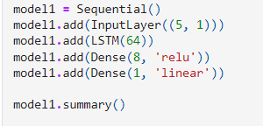
Bearing Temperature Method (ML model RNN ,LSTM)
Code Repo: https://github.com/nishant5kumar/Capstone
ETL
Read CSV file for the dataset
Perform scaling and transformation of data
RUN ALGORITHM
Train the model on ensemble techniques including Logistic Regression at the output layer.
VALIDATE OUTPUT
Predict mean value for next 30 mins using the equation and form a NumPy array
Finalized on the ML technique – (RNN)
Used Logistic regression at output layer with 1 class boundary limit at 65
PRINT RESULT
Range of accuracy across all dataset 89% - 99.7%

Slide 18
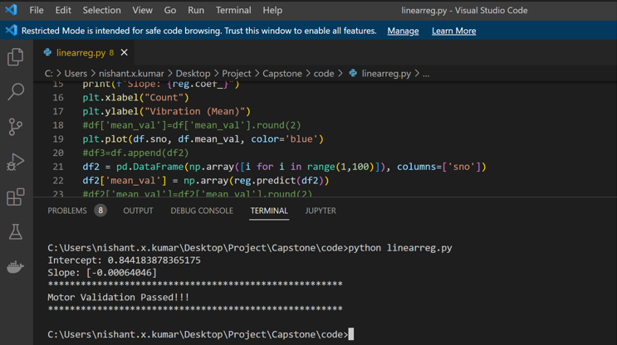
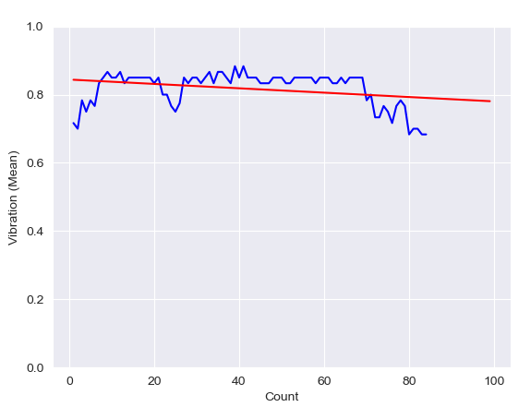
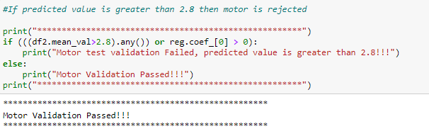
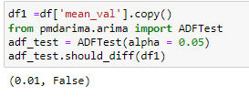
Vibration Prediction Method (Linear regression)
ETL
Capture 6 data points at every 1 minute interval , calculate mean
Capture mean data for 5 mins at every 1 min interval flagged as correct by the operator ,check distribution ,note the mean value.
RUN ALGORITHM
Consider values for regression with only similar distribution.
Find out coefficients of linear regression and intercept for the Y equation
VALIDATE OUTPUT
Predict mean value for next 30 mins using the equation and form a NumPy array
PRINT RESULT
RANGE OF R2 (0.0005 to 0.6548)

Slide 19
Hypothesis Testing
H0 : Singular ML model is not suitable across all product categories
Ha: Singular ML model is suitable across all product categories
Bearing temp prediction Model
Vibration prediction Model
Expected frequency less that 5
Expected frequency less that 5
Chi Squared : Test of Independence could not be inferred due to insufficient sample size , however the model can deployed for testing in real scenario where more data shall be generated and outcome will lead to a robust inference .

Slide 20
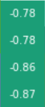
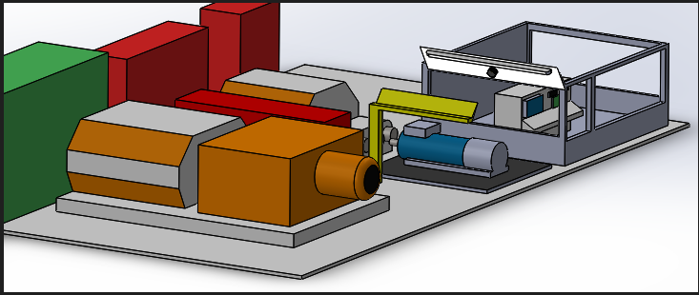
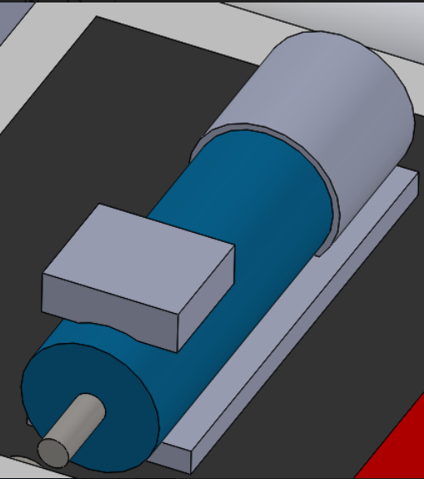

Ad hoc Insight
Objective of Testing for manufacturer and passing criteria
Attain Friction and Windage loss values within limit specified as per design.
Check for bearing temperature stabilisation values within 65 deg C
Check for motor vibration parameters and ensure values with 2.8 mm/sec before release.
The grease distribution over time reduces friction in bearing raceways and subsequently the Friction and windage losses gets reduced in a new motor but same has only relation with motor speed and no other electrical parameters.
Reason for Causation
Creating a small infrastructure at the motor waiting area can add to extra lead time and substantially reduce motor testing time.
A small 15 kW motor can be coupled to the shaft which can be run at calibrated speed for bearing temp stabilisation
TEST PLANT
MOTOR TO BE TESTED AT WAITING AREA
SMALL LT MOTOR FOR DRIVING
Inference: With this minor change motor testing time can be reduced to 30mins which will add to additional capacity per shift and substantial amount of power savings for the company

Slide 21






Review of existing work in the area
We are analyzing the following IEEE and IEC -60034-2-1 2017 studies for the purpose of reference: IEC 60034-2-1 Rotating electrical machines - Part 2-1: Standard methods for determining losses and efficiency from tests
The table on classification accuracies is taken from the above IEEE paper(for reference purpose only)

Slide 22
Thank You

Slide 23
Backup Slides

Slide 24
Linear Regression

Slide 25



Linear Regression
Linear Regression
Regression analysis is a predictive modelling technique
Ridge
Regression
Ridge regression is an extension of linear regression where the loss function is modified to minimize the complexity of the model.
Lasso Regression
Least Absolute Shrinkage and Selection Operator, is also a modification of linear regression. In Lasso, the loss function is modified to minimize the complexity of the model by limiting the sum of the absolute values of the model coefficients

Slide 26



Linear Regression
SGD
Regressor
SGD stands for Stochastic Gradient Descent: the gradient of the loss is estimated each sample at a time and the model is updated along the way with a decreasing strength schedule
Kneighbors Regressor
K nearest neighbors is a simple algorithm that stores all available cases and predict the numerical target based on a similarity measure
DecisionTree Regressor
A regression tree is basically a decision tree that is used for the task of regression which can be used to predict continuous valued outputs instead of discrete outputs.

Slide 27


Linear Regression
LGBM
Regressor
XGB
Regressor
LightGBM is a gradient boosting framework that uses tree-based learning algorithms.
XGBoost stands for "Extreme Gradient Boosting" and it is an implementation of gradient boosting trees algorithm.

